Slide 1
Rethinking Cache Hierarchy and Interconnect Design for Next-generation GPUs
Mohamed Assem Ibrahim
Ph.D. Candidate
https://massemibrahim.github.io/

Slide 2
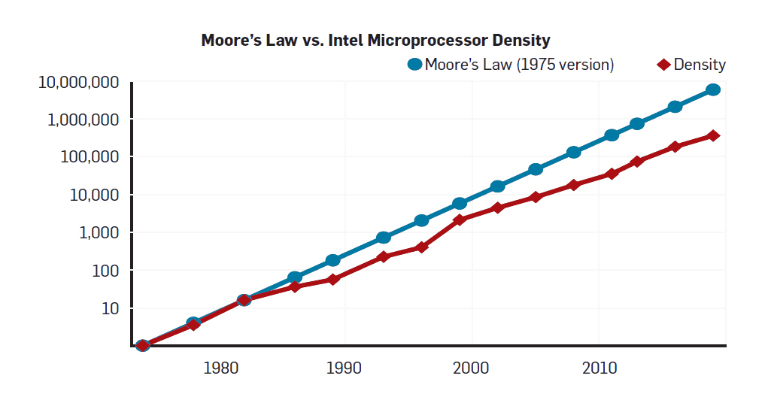
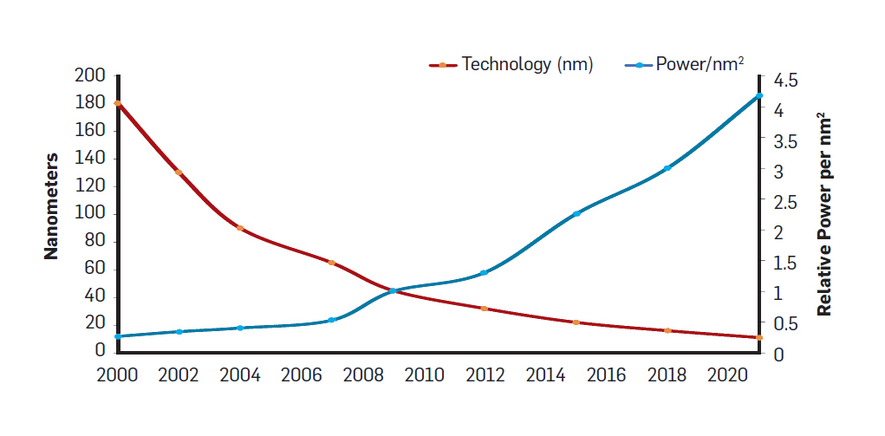
Diminishing Benefits!
High Performance
1) Moore’s Law
2) Dennard Scaling
2X Transistors / 18-24 Months
Higher Frequencies at the Same Power
Slowing Moore’s Law
Power Wall
Solution?
Hennessy & Patterson, “A New Golden Age for Computer Architecture.” Communications of the ACM 2019.

Slide 3
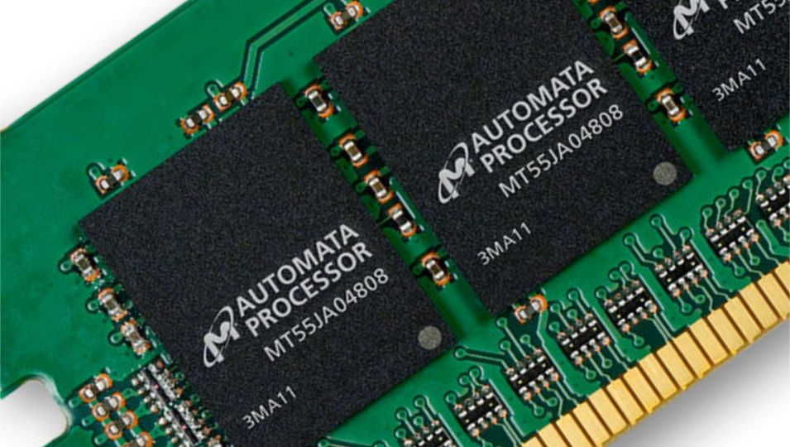
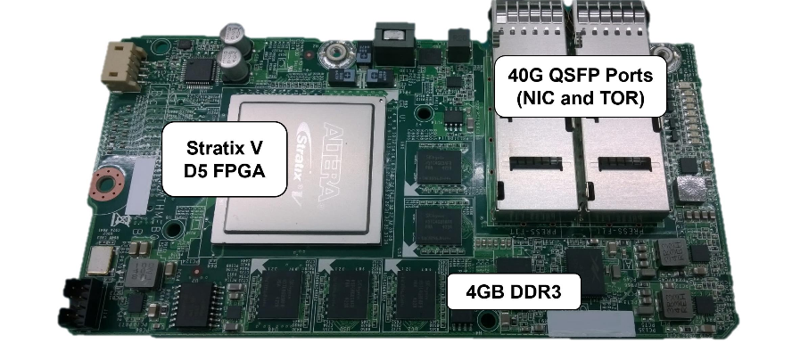
Domain Specific Architecture (DSA)
[Micron] Automata Processor
[Google] Tensor Processing Unit
[Microsoft] Catapult
[Google] Pixel Visual Core

Slide 4
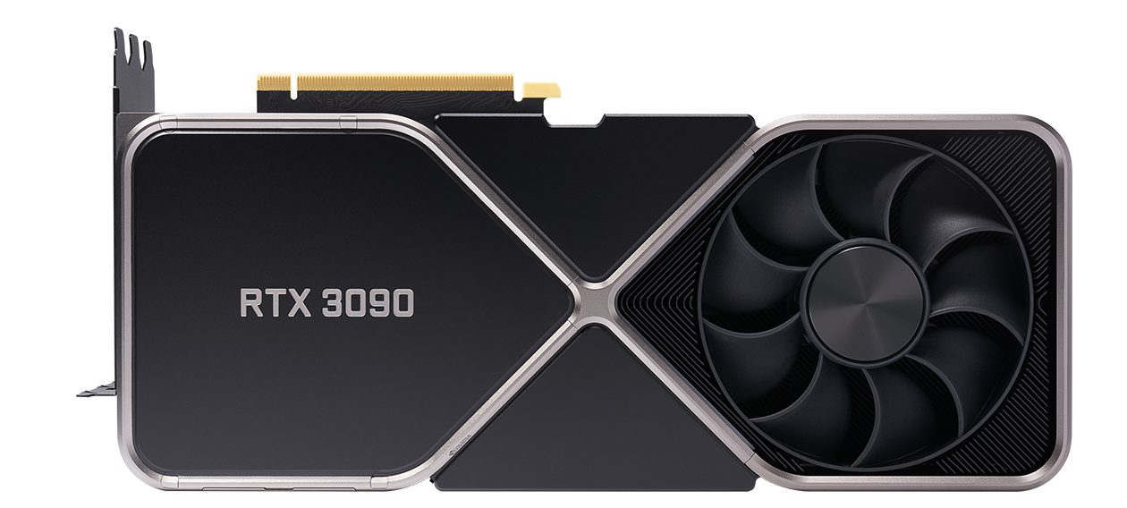
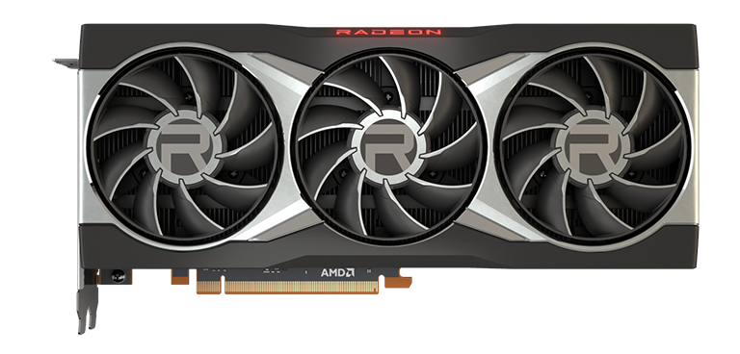
Graphics Processing Unit (GPU)

Slide 5
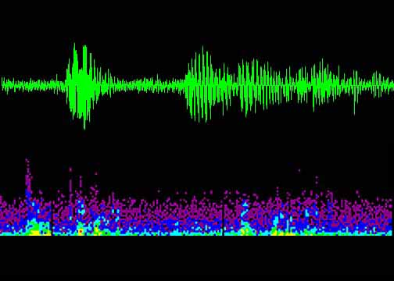
From DSA to General-purpose Architecture
Games
Content Creation
Physics
Simulation
Medical
Imaging
Machine
Learning
Multi-threading Capability
General-purpose Applications
Astronomy
Image/Audio Processing
Financial Computing
Genomics
General-purpose Computing on GPUs (GPGPUs)
High Data-Level Parallelism
General-purpose Applications
High Data-Level Parallelism
Execution Unit

Slide 6
GPUs are everywhere!

Slide 7
How Acceleration Works?
Core
CPU
GPU
Core
Application Code
Sequential Code
Parallel Code
Sequential Code
Few Cores
Large Number of Cores
Optimized for Latency
Optimized for Throughput
Great for Sequential Code
Great for Parallel Code

Slide 8
State of GPU Computing Application Trends
Large workloads/datasets.
Multi-application execution.
Increasing Computational Demand

Slide 9
State of GPU Computing Hardware Trends
GPU die sizes are getting larger.
Core count is increasing as well.
Wikipedia (Data)

Slide 10
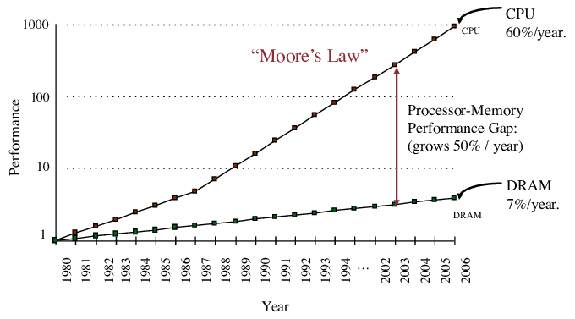
Problem?
Memory Wall
Processor
Moore’s Law
Performance
Processor-Memory Performance Gap
Memory
Year
Compute Boost is limited by Memory Bandwidth

Slide 11
Solution?
On-chip Caching Resources
GPU Core
Memory Partition
PE
…
PE
NoC
L2$
Register File
Memory
L1$
Scratchpad
Not Enough!

Slide 12
Scale Bandwidth Resources?
1) Cost Limitation
2) Power Limitation
3) I/O Limitation

Slide 13
Dissertation Statement
Improve On-chip Memory Bandwidth Utilization
to Enable the Next-generation of GPUs
Via Rethinking Cache Hierarchy & Interconnect

Slide 14
Outline
Conventional Cache/Interconnect Hierarchy
Dissertation Research
Conclusions & Future Work

Slide 15
GPU Architecture
GPU Core
GPU Core
PE
…
PE
PE
…
PE
Assign Work → GPU Core
Function (Kernel) + Data
Run Threads → PEs
PE = Processing Element
Read/Write Data? → LD/ST Unit
LD/ST = Load/Store
Coalesce Read Requests
Check L1 Cache
Read Request Pending? → MSHR
MSHR = Miss-Status Holding Register
Check L2 Cache
Check Global Memory
LD/ST Unit
…
LD/ST Unit
Coalescing Unit
Coalescing Unit
L1 Cache
L1 Cache
MSHR
MSHR
Interconnect (NoC)
L2 Cache
MSHR
Global Memory (DRAM)

Slide 16
Conventional Cache/NoC Hierarchy
Private
L1
2 Replication of data (cache line) across L1 caches
Core
Core
Core
Core
Core
Core
Core
Core
Core
Core
Core
Core
L1
L1
L1
L1
L1
L1
L1
L1
L1
L1
L1
L1
Network-on-Chip (NoC)
Reply
1 L1 bandwidth is underutilized
& L2 bandwidth is a bottleneck!
77% cores requests
served @ L2
L2
L2
L2
High queueing delay
L2
L2
Memory
Memory
Memory
Memory
Pattnaik, et al. “Opportunistic Computing in GPU Architectures.” ISCA’19.

Slide 17
Why Replication? Breadth First Search (BFS)
Node
0
Node
1
Core A
0
2
Node
2
Core B
1
2
Assume node 0 and 1 are processed by different cores.
Accessing Shared Data Structures → Data Replication
Li, et al. “Inter-Core Locality Aware Memory Scheduling.” CAL’15.

Slide 18
Volume of Replication
Fraction of the L1 read misses that can be satisfied by ≥ 1 remote core.
Replication Volume
Replication Ratio = 95%
Replica Count = 22

Slide 19
Data Replication
PACT’19
PACT’20, HPCA’21
Can be utilized as a source of bandwidth
Can be viewed as a waste of cache capacity
More Replication = Sources of Bandwidth
Zero Replication =
More Capacity

Slide 20
Outline
Conventional Cache/Interconnect Hierarchy
Dissertation Research
Exploiting Data Replication
Unlocking Remote-core Bandwidth in GPUs
Eliminating/Reducing Data Replication
A Case for Shared L1 Caches in GPUs
Aggregated Decoupled Caches for GPUs
Conclusions & Future Work

Slide 21
Dissertation Research
Exploiting Data Replication
Remote-core Bandwidth
[PACT 2019]
Analyzing and Leveraging Remote-core Bandwidth for Enhanced Performance in GPUs
Mohamed Assem Ibrahim, Hongyuan Liu, Onur Kayiran, Adwait Jog

Slide 22
Let's Bake Cookies!
Ingredients:
Peanut Butter
Sugar
Eggs
Chocolate Chips
Neighbors = Additional Source of Ingredients!

Slide 23
Remote-core Bandwidth
Use Remote Cores
(as additional bandwidth source)
Replication/Sharing of Data across Cores
A
B
Core
Core
Core
Core
Core
Core
Core
Core
Core
Core
Core
Core
L1
L1
L1
L1
L1
L1
L1
L1
L1
L1
L1
L1
Request
Network-on-Chip
Efficient Inter-core Communication
Request
Reply
Reply
L2
L2
L2
L2
L2
Memory
Memory
Memory
Memory

Slide 24
Challenges?
Not all PCs (program
counter) are equal!
Which data is shared?
Not every cache line is shared across cores
PC-based Sharing Predictor

Slide 25
Challenges?
Not all remote cores are equal!
Which remote cores have the shared data?
Not every core has the shared data
Supplier-based Core Selector

Slide 26
Challenges?
Redundant replies!
How to fetch the shared data?
Send parallel probes
Leader
Scout
Two-level Probing
Scout
Scout

Slide 27
Evaluation
Handle the absence of data replication without degrading performance!
<1%
Drop
10%
Results are normalized to Baseline (no inter-core communication).
Under an impaired NoC with a single virtual channel.
Average = 10%, Max = 26%
With 4 shallow virtual channels → Average = 21%, Max = 53%

Slide 28
Outline
Conventional Cache/Interconnect Hierarchy
Dissertation Research
Exploiting Data Replication
Unlocking Remote-core Bandwidth in GPUs
Eliminating/Reducing Data Replication
A Case for Shared L1 Caches in GPUs
Aggregated Decoupled Caches for GPUs
Conclusions & Future Work

Slide 29
Dissertation Research
Eliminating/Reducing Data Replication
Shared L1 Caches
[PACT 2020]
Analyzing and Leveraging Shared L1 Caches in GPUs
Mohamed Assem Ibrahim, Onur Kayiran, Yasuko Eckert,
Gabriel H. Loh, Adwait Jog

Slide 30
Let's Bake Cookies!
Ingredients:
Peanut Butter
Sugar
Eggs
Chocolate Chips
Agree that each one of us will buy and keep one type only!
No Replication = Additional Ingredients in the Building!

Slide 31
Shared L1 Caches
Shared L1
Private L1
= Replication Eliminated!
= Replication of L1 Data across Cores
Addr.
Range A₀
Addr.
Range A₁
Addr.
Range A₂
…
…
…
…
…
Addr.
Range A_{n-1}
Full Addr.
Range
Full Addr.
Range
Full Addr.
Range
Addr.
Range A₃
Full Addr.
Range
Full Addr.
Range
Full Addr.
Range
Full Addr.
Range
…
Full Addr.
Range
Addr.
Range A_{n-2}
Full Addr.
Range
Full Addr.
Range
Full Addr.
Range
Full Addr.
Range
Unique Addr. Range Slice
Core
Core
Core
Core
Core
Core
Core
Core
Core
Core
Core
Core
L1
L1
L1
L1
L1
L1
L1
L1
L1
L1
L1
L1
Req.
Core
Home
Core
Do not Cache!
Network-on-Chip
Request
Reply
Efficient Inter-core Communication
L2
L2
L2
L2
L2
Memory
Memory
Memory
Memory

Slide 32
Shared L1 Caches
Solution?
5%
Drop
80%
Drop
Eliminate Replication → Lower L1 Miss Rate
Performance drops by 5%!
Naïve Communication → 2.2X Latency Overhead

Slide 33
Optimized Shared L1 Caches Reduce Wasted NoC Bandwidth
32B | 32B | 32B | 32B
Cache Line
Chunking
Reply from Home only has requested data by the Requester.

Slide 34
Optimized Shared L1 Caches Shared++
Replication-insensitive
Applications?
Eliminate Replication → Lower L1 Miss Rate
Performance improves by 26%!
Optimized Communication → 9% Latency Overhead

Slide 35
Handling Private-friendly Applications
Sampling Phase
Execution Phase
Collect counters.
Check end of phase.
Evaluate metrics.
Choose Shared or Private cache organization.
Execute with chosen organization.
Check end of phase.

Slide 36
Handling Private-friendly Applications Sampling Phase
Set
Legend
Request Address
Sets treated as Private
LSB of Set bits
Sets treated as Shared
DynEB → Effective BW (EB)
$$EB= \frac{{L2}_{Replies}}{L1 Miss Rate}+ {Home}_{Replies}$$
BW-based Metric
EB $∝$ IPC
Local
Core
L1 Cache
Even
0?
Odd
Set 0
Set 1
Set 2
Set 3
Set 4
Set 5
. .
Set 30
Set 31
Private Stats
Shared Stats
Local L1 Requests
Local L1 Requests
L1 Requests
L1 Requests
Counters
L1 Misses
Counters
L1 Misses
Replies from L2
Replies from L2
Replies from Homes
Replies from Homes
Sampling
Completed?
Evaluate Sampling Stats
Private or Shared
Yes
Wang, et al. “Efficient and Fair Multi-programming in GPUs via Effective Bandwidth Management.” HPCA’18.

Slide 37
Evaluation IPC
Replication-sensitive
Private-friendly
22%
Results are normalized to Private L1 organization baseline.
Replication-sensitive Applications → Average = +22%, Max = +53%
Private-friendly Applications → Average = -4%

Slide 38
Outline
Conventional Cache/Interconnect Hierarchy
Dissertation Research
Exploiting Data Replication
Unlocking Remote-core Bandwidth in GPUs
Eliminating/Reducing Data Replication
A Case for Shared L1 Caches in GPUs
Aggregated Decoupled Caches for GPUs
Conclusions & Future Work

Slide 39
Dissertation Research
Eliminating/Reducing Data Replication
Decoupled L1 Caches
[HPCA 2021]
Analyzing and Leveraging Decoupled L1 Caches in GPUs
Mohamed Assem Ibrahim, Onur Kayiran, Yasuko Eckert,
Gabriel H. Loh, Adwait Jog

Slide 40
Let's Bake Cookies!
Ingredients:
Peanut Butter
Sugar
Eggs
Chocolate Chips
Need a way to communicate
with my neighbors.
Disrupt my neighbors!
Remove the fridge from each apartment.
Put them in a common area.
Agree that each one of us will buy and keep one type only!
Solution?

Slide 41
Conventional Cache/NoC Hierarchy
Solution?
Improving L1 bandwidth utilization requires:
NoC overhead to enable inter-core communication.
Under both 2D mesh and crossbar!
Disrupting the Home core.
Arbitration between local and remote requests.
Core
L1
NoC
L2
Memory
Problem Source: Tightly-coupled GPU core and L1 cache!

Slide 42
Decoupled L1 Caches (DC-L1s)
Separate L1 cache from the GPU core.
Break the tight-coupling!
Lite GPU Core
(No L1 Cache)
…
0
1
2
3
4
5
A-2
A-1
NoC#1 (Core ↔ DC-L1)
DC-L1
(Decoupled L1)
…
Level-1
Cache
Two-level Cache
Hierarchy
0
1
2
3
4
5
A-2
A-1
NoC#2 (DC-L1 ↔ L2)
…
C-1
Level-2
Cache
L2+Memory
0
1
2
3
4
5
C-2

Slide 43
Aggregating DC-L1 Caches
Example of aggregating two DC-L1s.
Lite Core
DC-L1
L2
Merge X DC-L1s to form one bigger DC-L1 cache.
Reduced replication
Better L1 bandwidth utilization
Lower peak L1 bandwidth
…
0
1
2
3
78
79
2x1 XBar
2x1 XBar
…
2x1 XBar
2x1 XBar
2X
Size
…
0
0
1
1
38
39
40x32 XBar
…
0
1
2
30
31
Aggregation Granularity?

Slide 44
Aggregation Granularity
Metric | Low Aggregation | High Aggregation
Replication Volume
Peak L1 Bandwidth
NoC Area/Power

Slide 45
Aggregation Granularity Verdict
Pr40: Aggregate two DC-L1s into one 2X DC-L1.
IPC = 15% boost
NoC Area = 28% lower
NoC Power = 4% lower
L1 Miss Rate = 19% lower → High Replication!
Shared DC-L1s?

Slide 46
Shared DC-L1 Caches
Assume 80-core System with 40 DC-L1s
(Aggregation Granularity = 2).
Shared cache organization across DC-L1s.
Eliminate replication.
Use 80x40 crossbar in NoC#1.
Enable communication between a given core to all DC-L1 caches.
Lite Core
DC-L1
L2
…
0
1
2
3
78
79
80x40 XBar
…
Unique Addr. Range Slice
2X
Size
0
1
38
39
40x32 XBar
…
0
1
2
30
31

Slide 47
Shared DC-L1 Caches Verdict
Replication-insensitive
Applications?
Sh40: 40 aggregated and shared DC-L1s under 80-core system.
IPC = 48% boost
L1 Miss Rate = 89% lower = Replication Eliminated!
NoC Area = 69% higher
NoC Power = 57% higher
Clustered Shared DC-L1s?

Slide 48
Clustered Shared DC-L1 Caches
Assume 80-core System with 40 DC-L1s.
Lite Core
DC-L1
L2
Shared cache organization across a cluster of DC-L1s.
Eliminate replication within a cluster.
Limit overall replication.
Use smaller crossbars in NoC#1.
Enable communication between a given core to all DC-L1 caches in a cluster.
…
…
…
0
1
7
72
73
79
8x4 XBar
…
8x4 XBar
Unique Addr. Range Slice
0
1
2
3
…
36
37
38
39
0
1
2
3
36
37
38
39
C0
C1
C2
C3
C9
C0
C1
C2
C3
C9
10x8 XBar
10x8 XBar
0
1
2
7
24
25
26
31
…
…
…
0
1
2
7
24
25
26
31
Choose 10 Clusters (Sh₄₀+C₁₀)
IPC Boost + Replication Reduction + Reduced Area/Power
Clusters Count?

Slide 49
Frequency-boost Optimization
…
0
1
7
8x4 XBar
0
1
2
3
Smaller Crossbars = Higher Operating Frequency
Optimization → Double the NoC frequency in NoC#1
Sh₄₀+C₁₀+Boost

Slide 50
Evaluation IPC
Replication-sensitive
Poor-performing
8x
5x
75%
Results are normalized to Private L1 organization baseline.
Replication-sensitive Applications → Average = +75%, Max = +8X
Poor-performing Applications → Average = -5%

Slide 51
Outline
Conventional Cache/Interconnect Hierarchy
Dissertation Research
Exploiting Data Replication
Unlocking Remote-core Bandwidth in GPUs
Eliminating/Reducing Data Replication
A Case for Shared L1 Caches in GPUs
Aggregated Decoupled Caches for GPUs
Conclusions & Future Work

Slide 52
Conclusions
Goal: To support the continuous scaling of compute throughput, it is crucial to conserve and improve on-chip memory bandwidth utilization.
Direction: Analyze and leverage data replication across the L1 caches to improve their utilization and boost on-chip bandwidth.
Contributions:
[PACT’19] Develop probing mechanisms to efficiently unlock remote-core bandwidth, an additional source of bandwidth in GPUs.
[PACT’20] Propose a renovated cache design that enables both private and shared cache organization for L1 cache.
[HPCA’21] Propose co-designing the cache hierarchy and the interconnect and present DC-L1 cache, an L1 cache decoupled from the GPU core.

Slide 53
Future Research Directions
Short-term: Improve on-chip bandwidth utilization by considering other bandwidth sources
How to leverage data replication between the L1 and L2 caches?
How to leverage value locality and predictability to extend the scope of data replication?

Slide 54
Future Research Directions
Long-term: Investigate graphics pipeline & workloads
Critical from business & research perspectives
Goals:
Profile & Analyze graphics workloads
Understand & Optimize the underlying hardware

Slide 55
Timeline
[Spring’16]
Joined William & Mary + Started working with Prof. Adwait Jog
[Fall’17]
Passed Ph.D. Candidacy
[Fall’19]
Dissertation Proposal
Today
[Spring’21]
Dissertation Defense
[Spring’21]
Postdoc @ AMD Research
[Summer’18]
Internship @ AMD Research
[Summer + Fall’20] Internship @ AMD Research

Slide 56
Publication List
[PACT’19] Mohamed Assem Ibrahim, Hongyuan Liu, Onur Kayiran, Adwait Jog Analyzing and Leveraging Remote-core Bandwidth for Enhanced Performance in GPUs
[PACT’20] Mohamed Assem Ibrahim, Onur Kayiran, Yasuko Eckert, Gabriel Loh, Adwait Jog Analyzing and Leveraging Shared L1 Caches in GPUs
[HPCA’21] Mohamed Assem Ibrahim, Onur Kayiran, Yasuko Eckert, Gabriel Loh, Adwait Jog Analyzing and Leveraging Decoupled L1 Caches in GPUs

Slide 57
Publication List
[ICS’19] Haonan Wang, Mohamed Assem Ibrahim, Sparsh Mittal, Adwait Jog Address-Stride Assisted Approximate Value Prediction in GPUs
[MICRO’18] Hongyuan Liu, Mohamed Assem Ibrahim, Onur Kayiran, Sreepathi Pai, Adwait Jog Architectural Support for Efficient Large-Scale Automata Processing
[HPCA’18] Haonan Wang, Fan Luo, Mohamed Assem Ibrahim, Onur Kayiran, Adwait Jog Efficient and Fair Multi-programming in GPUs via Effective Bandwidth Management
[HPCA’17] Xulong Tang, Ashutosh Pattnaik, Huaipan Jiang, Onur Kayiran, Adwait Jog, Sreepathi Pai, Mohamed Assem Ibrahim, Mahmut T. Kandemir, Chita R. Das Controlled Kernel Launch for Dynamic Parallelism in GPUs

Slide 58
Thank You!

Slide 59
Thanks to all the committee members and audience!

Slide 60
Rethinking Cache Hierarchy and Interconnect Design for Next-generation GPUs
Questions?
Mohamed Assem Ibrahim
Ph.D. Candidate
https://massemibrahim.github.io/

